Slide 1
MINI PROJECT
ON CLASSIFICATION

Slide 2
MINI PROJECT ON CLASSIFICATION
TABLE OF CONTENTS –
Explanation of what the project is all about ?
Describing the data : Its source, datatypes, description and information.
Data Pre - Processing techniques used, How the missing value is handled and Feature engineering techniques used.
EDA and the interpretations from your visualizations.
Model building : whether used one model or more, Algorithms used in the model and the reason for choosing it and Cross validation result if used.
Evaluation of the performance of the models, and final conclusion of best model which can be used.

Slide 3
What the project is all about...
We have came across many property buyers with different requirements. To facilitate this, real estate companies prefer categorizing various houses into different grades based on various parameters. This would help agents in identifying the type of house a customer is looking for. This way, the search for the house can be narrowed down by focusing only on the ‘condition of the house’.
The Grade (condition of the house that ranges from A (Best) — E (Worst) ) can also be used by existing owners to list their properties for sale. Grading helps them in arriving at a price of the house.
To get the better results for property owners, building a predictive model to determine the grade of house from A to E is required.

Slide 4
Describing the Data
The data contains total 3000 rows and 14 columns. Following are the columns and dtypes
FEATURE | DATA TYPE | DESCRIPTION
Id | Numeric | Unique record identification number
Totalarea | Numeric | Total area of the house
Trooms | Numeric | Number of rooms in the house
Nbedrooms | Numeric | Number of bedrooms in the house
Nbwashrooms | Numeric | Number of attached washrooms with bedroom
Twashrooms | Numeric | Total number of washrooms
Roof | Categorical | Does the house have a roof
FEATURE | DATA TYPE | DESCRIPTION
Roofarea | Numeric | Area of the roof
Lawnarea | Numeric | Area of the lawn
Nfloors | Numeric | Total floors
API | Numeric | Air pollution index level
Expected price | Numeric | Approximate cost price of the property
Grade | Categorical | The grade of the house/property

Slide 5
Data Pre-Processing Techniques
Null Value Treatment - In Pre-Processing, First of all we checked for empty values, there were no empty values in Grade, so there is no need of missing value imputation.
Label Encoding - Then the non numeric data type feature were converted into numeric type as the machine understands numeric values very well using the method(Label Encoder).
Feature Scaling - The data is then scaled(converted into a certain range) using the function MinMaxScaler(used to normalize the values of columns between 0 and 1) for easy and fast processing.
Feature Selection - For feature selection, on the basis of relation between multiple columns with Grade we determine the best correlated columns and then they were selected for further modelling of different algorithms.
Splitting the data – The data is splitted using Repeated Stratified Kfold CV with 5 splits. The data is splitted between Training data which is used to train the model and test data

Slide 6
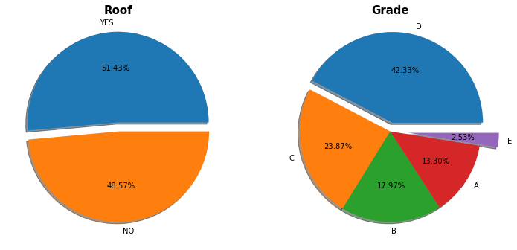
Exploratory Data Analysis
Interpretation :
Here we can see that the 51.43% of the House have Roof and 48.57% don’t have any.
The D grade have the maximum percentage 42.33% and Grade E have the least 2.53%.

Slide 7
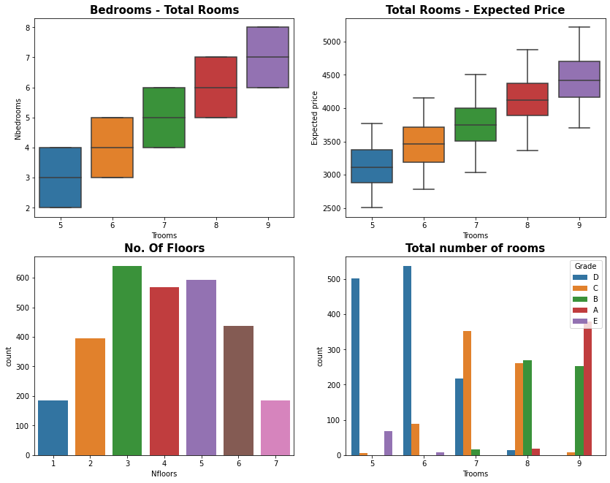
Exploratory Data Analysis
Interpretation :
Here we can see that the Most of the count is of 3 Floors Building and 1 and 7 have the least.
In Total Number of rooms Graph, in 5 and 6 rooms, Grade D have the highest count, in 7 rooms Grade C have more counts in 8 rooms Grade B have higher counts than others and in 9 rooms Grade A have higher counts than any other grade.

Slide 8
Model Building
There were total 4 models used to get the best model which can give the best performance and prediction. Following are the models
Naïve Bayes Model.
Decision Tree Classifier
Random Forest Classification
Stacking Classification
The main motive to use these models was to get best Accuracy from the model and compare them. As the target class is multiclass, use of Classification Algorithm will be the best option. Evaluation has been done using Accuracy, Precision, Recall and F1 score.

Slide 9
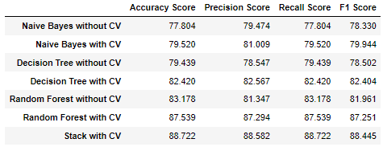
Evaluation and Final Conclusion of Best Model
Final Conclusion -
There were 4 models prepared for getting the best Score, Naïve Bayes, Decision Tree Classifier, Random Forest Classifier and Stacking Classifier.
Stacking Classifier can be said as best model among other models.
As the F1 score is comparatively good than other models
The Accuracy, Precision and Recall Score is good.
As we can see from the tabular form of all the scores, Stacking Classifier performs well in every Score.

Slide 10
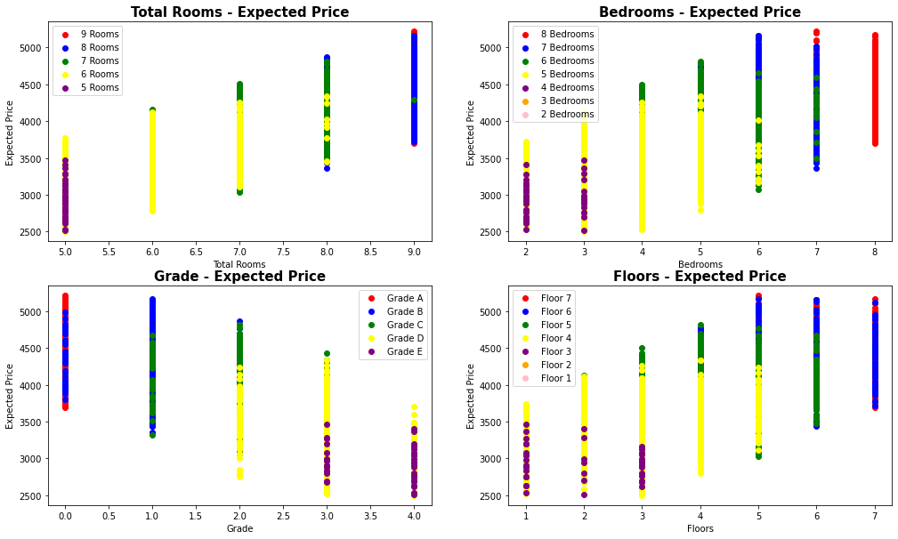
Business Implication
There are 51.43% of houses which have roof and 48.57% don't have roof of their house.
In D grade 42.33% have maximum percentage of share in houses and E have the least 2.53%, so getting a D grade house is easier.
Most of the building are of 3 Floors having count up to 250 and least for 1 and 7 floors where the counts is ~80.
Most of the Roof area is 90 in the 51.43% of roof houses.

Slide 11
Business Implications
Buyer can get a house easily in most expected price of 3500-4000 with area 295-355.
In 5 and 6 rooms, Grade D have the highest count, in 7 rooms Grade C have more counts, in 8 rooms Grade B have higher counts than others and in 9 rooms Grade A have higher counts than any other grade.
In Grade and Expected price graph, Grade A have highest Expected price from 3600 to more than 5000 and Grade D and E have price range from 2500 to 4500. Most of the count is of Grade C and D.
In Floors and Expected Price graph, 6 and 7 Floor building have highest price and least for 1,2,3 and 4 floor building. Most of the building have floors of 3,4 and 5.
So, On the basis of above business implication buyer can decide the way he/she wants to buy the house.

Slide 12
THANK YOU

